Slide 1


A Machine Learning Model
for Turning Point Prediction
in the Oil Market

Slide 2
Background
Crude Oil is a primary energy source with a big impact on the global economy.
The oil price is determined by Supply and Demand in the physical market [1]
Accurately identifying oil price Turning Points is essential economic planning and risk management.[2]
Notes:
My undergraduate major was geography, and I’ve always been interested in energy. That’s why I chose oil.
Crude oil is a primary energy source and has a huge impact on the global economy. The oil market is very important, but also very unpredictable. Prices can change a lot because of things like supply, demand, inventory, and OPEC policies.
If we can predict when the market will change direction—what we call a “turning point”—it can help companies make better decisions.

Slide 3
Objective
Implement a machine learning model to predict turning points in oil supply chain dynamics by integrating multi-source data
supply data
Inventory data
policy events
oil price data
The model aims to detect market shifts early
and support timely decision-making.

Slide 4
Data
supply and demand
JODI oil supply data（https://data.nasdaq.com/databases/JODI ）
EIA（Energy Information Administration）-Commercial crude oil inventory(WCESTUS1)：
（https://api.eia.gov/v2/petroleum/stoc/wstk/data/）
policy events
OPEC Events Data（https://www.opec.org ）
oil price data
WTI Crude Oil Prices（https://fred.stlouisfed.org/series/DCOILWTICO ）
Notes:
I collected data on oil supply, US inventory, OPEC policy events and WTI price
For the EIA data, I only used commercial crude oil inventory, not the strategic reserves.
For OPEC, I divided policy events into seven types, like meeting, cut, maintain, and so on, and turned them into features.

Slide 5
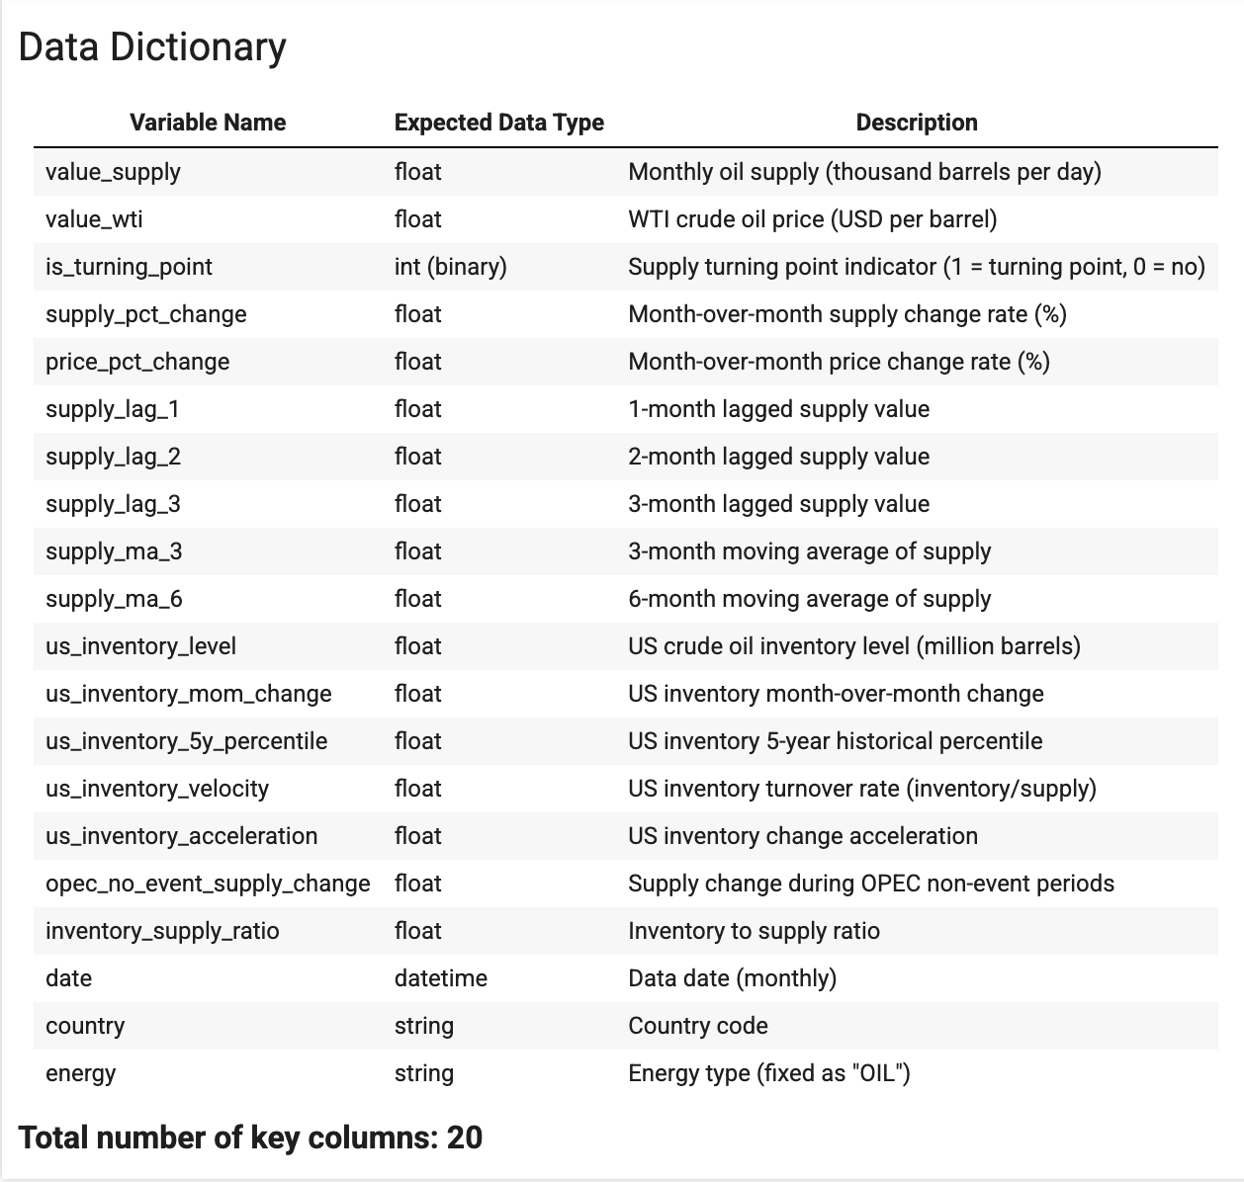
Final Integrated Dataset
Time Frequency
All data aligned to monthly frequency
Month-end values used for consistency
Time range: 2002-2024
Notes:
All the data was aligned to a monthly frequency, using month-end values for consistency, and the time range is from 2002 to 2024.
I also created new features , like moving average、lagged features to help the model learn better.

Slide 6
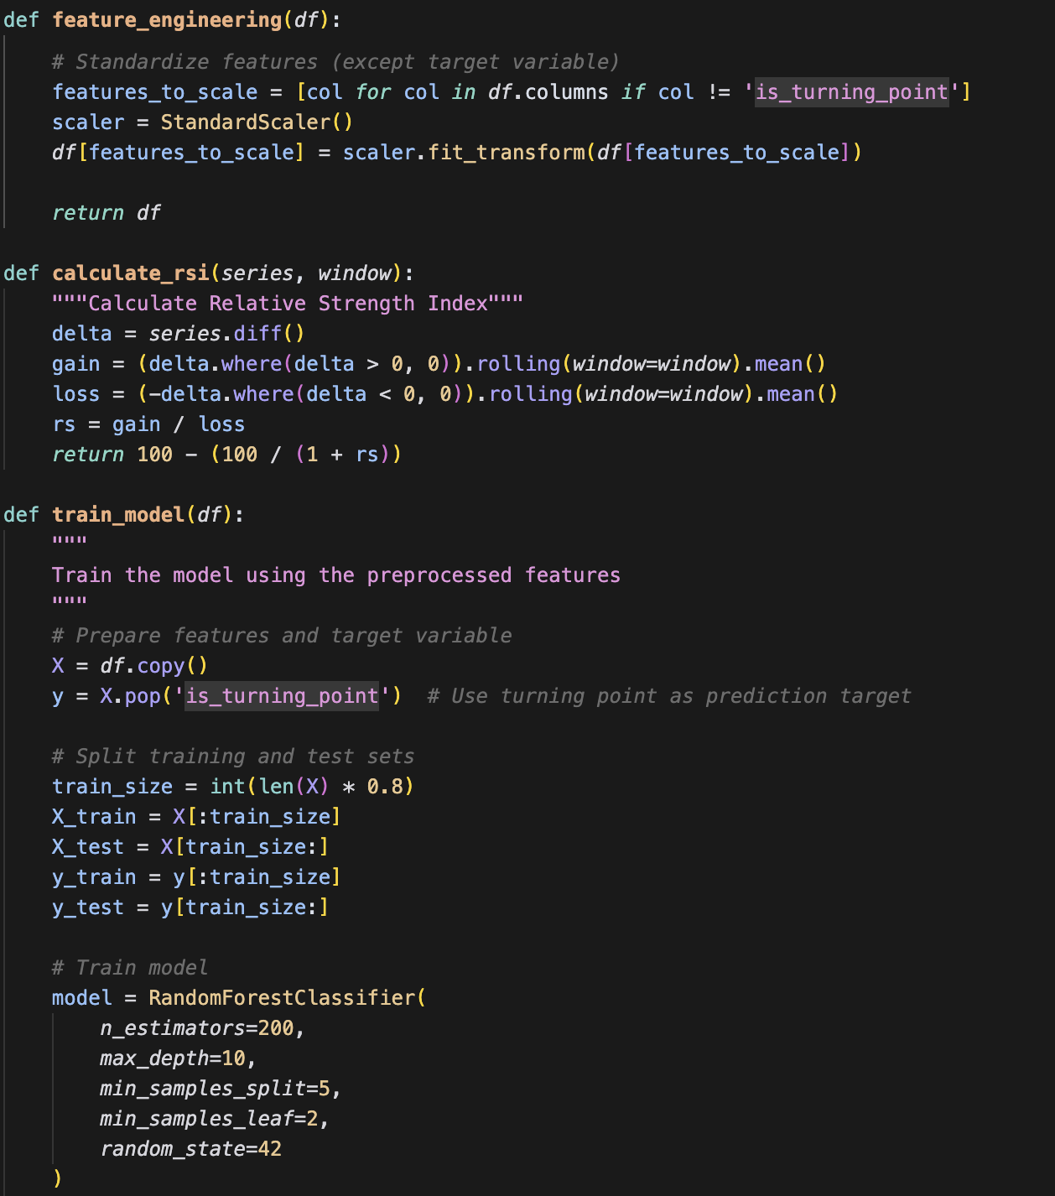
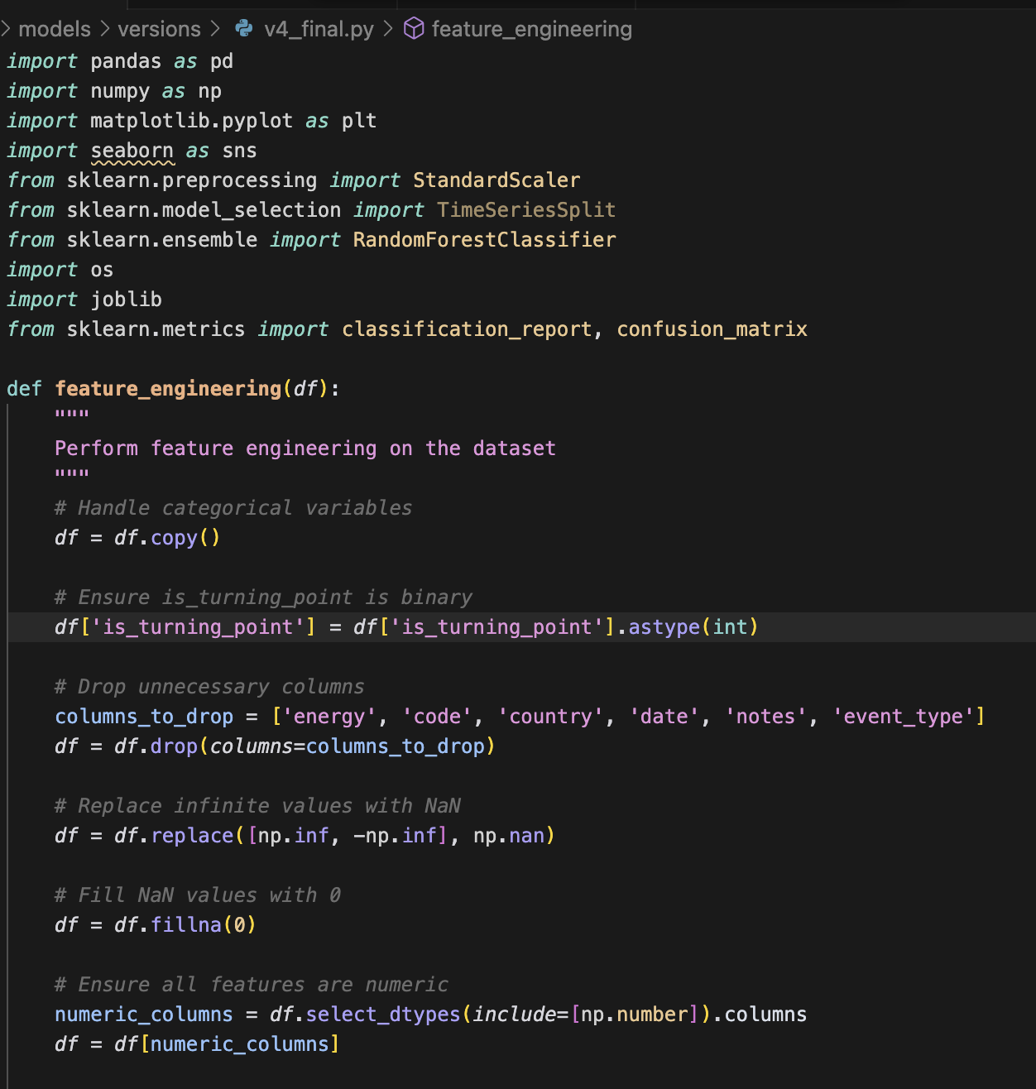
Final Model 4
80/20 train-test split
Notes:
I tried four different models, and the final one—a Random Forest—worked best.
Random Forest is good at finding patterns in complex data, especially when there are many features and non-linear relationships.
I split the data by time: 80% for training, 20% for testing, to make it more realistic.

Slide 7
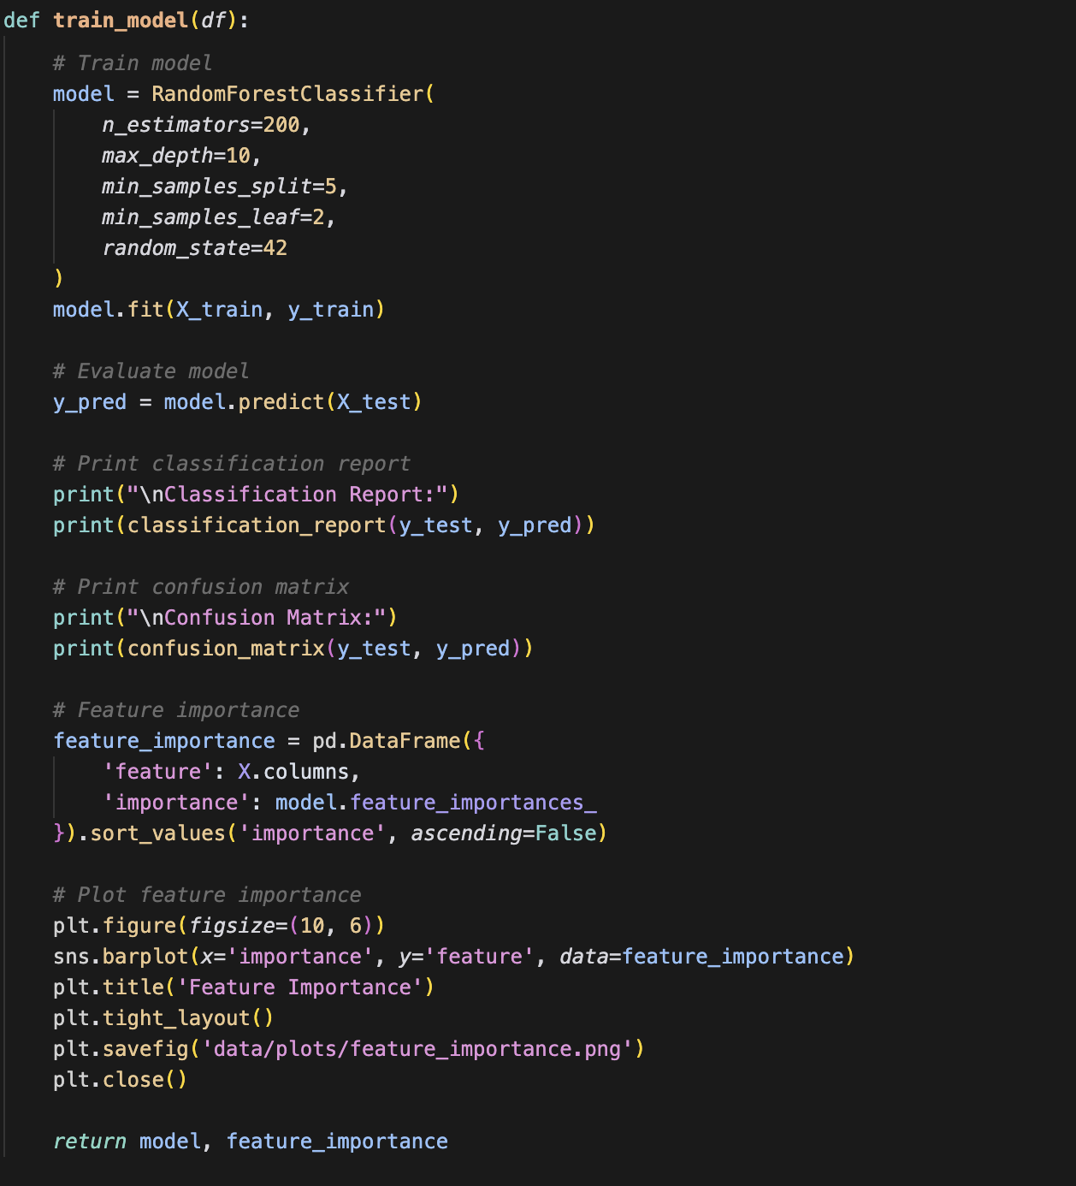
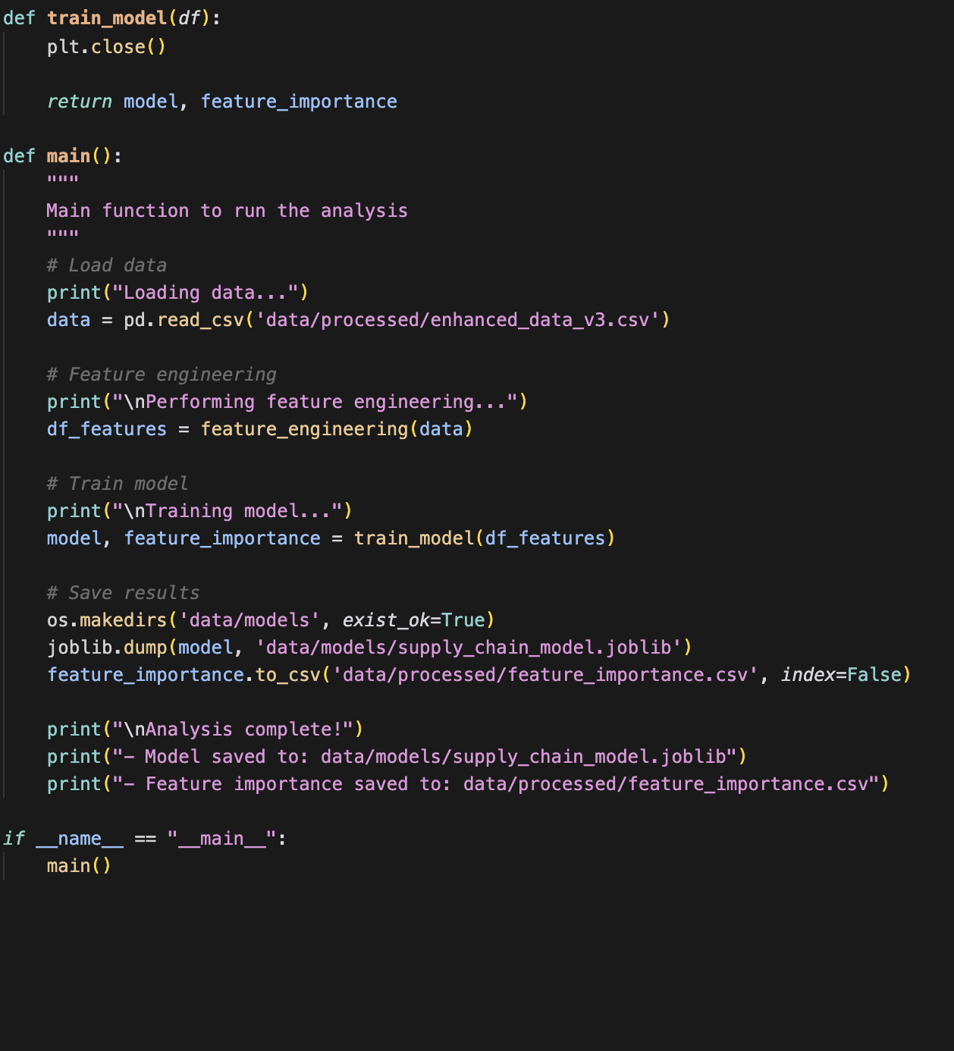

Slide 8
Definition of Turning Point
A point where oil supply changes direction
Can be either a peak (highest point) or a valley (lowest point)
Marked as 1 (turning point) or 0 (not a turning point)
How to Find Turning Points
RandomForestClassifier
An ensemble learning method using multiple decision trees
Good for handling non-linear relationships and feature interactions
Convert is_turning_point to binary integer type
def mark_turning_points(data, value_col='value_supply', window=3):
values = data[value_col].values
is_turning = np.zeros(len(values), dtype=int)
half_w = window // 2
for i in range(half_w, len(values) - half_w):
window_slice = values[i - half_w: i + half_w + 1]
center = window_slice[half_w]
if center == np.max(window_slice) or center == np.min(window_slice):
is_turning[i] = 1
data['is_turning_point'] = is_turning
return data
Notes:
The model’s job was to predict if each time point is a turning point or not.
A turning point is when the oil supply changes direction, either a peak or a valley. I marked these as 1 for turning point, and 0 for not a turning point.

Slide 9
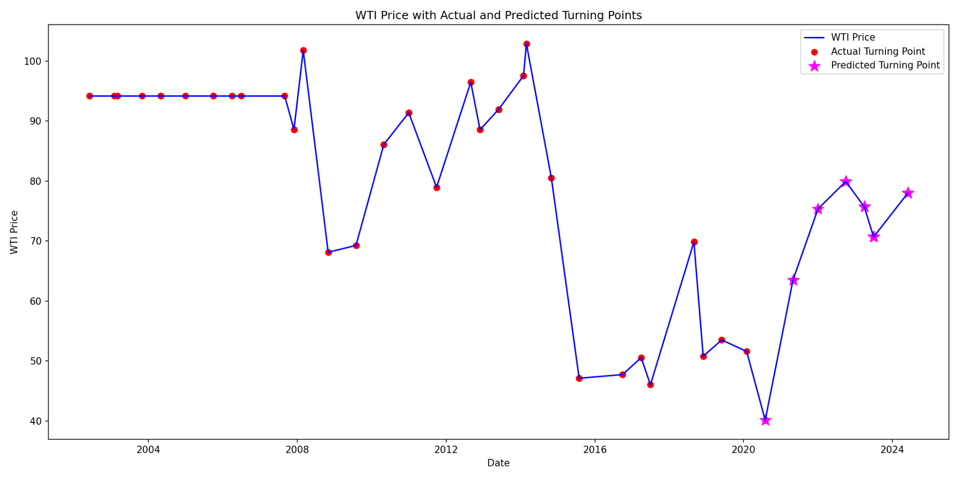
Results
accuracy 0.82 38
80/20 train-test split
Notes:
The model got about 82% accuracy on the test set. You can see these predicted turning points.

Slide 10
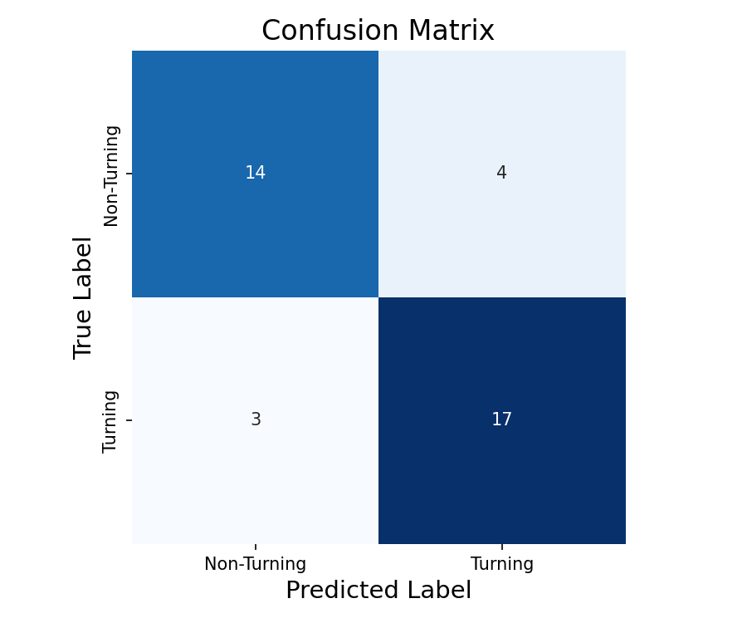
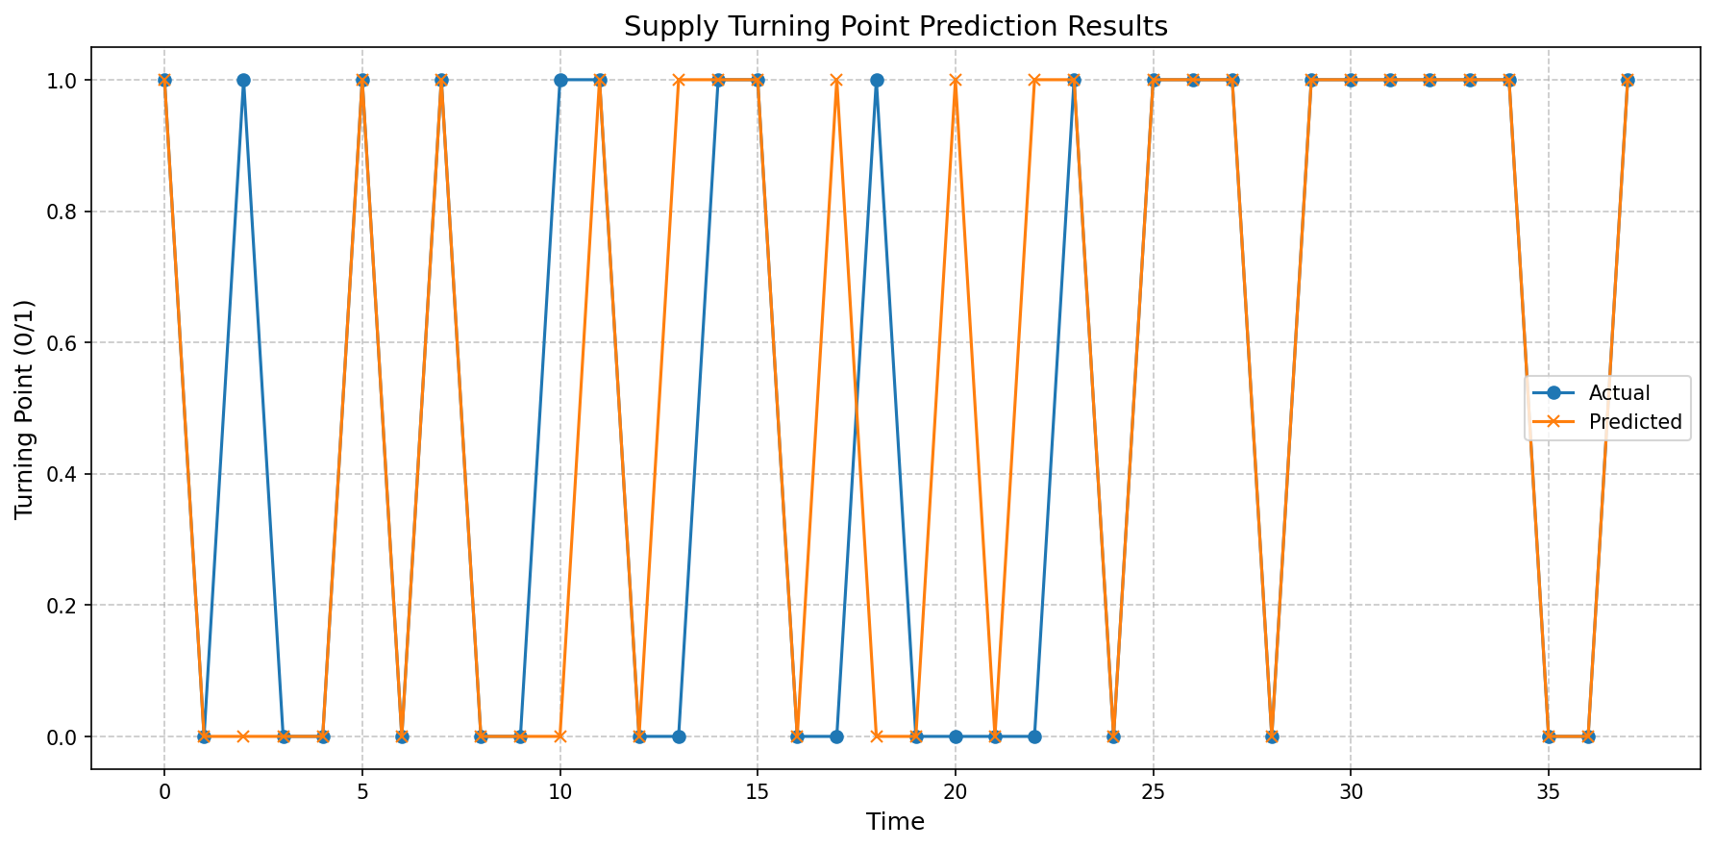
Results
Classification Report:
precision recall f1-score support
0 0.82 0.78 0.80 18
1 0.81 0.85 0.83 20
accuracy 0.82 38
macro avg 0.82 0.81 0.81 38
weighted avg 0.82 0.82 0.82 38
Notes:
I used accuracy, recall, F1-score, and a confusion matrix to see how well the model worked.
Most of the time, it could tell if there was a turning point or not, and the confusion matrix shows only a few mistakes.
I also made some visualizations, like feature importance and correlation heatmaps, to see what’s really driving the predictions.

Slide 11
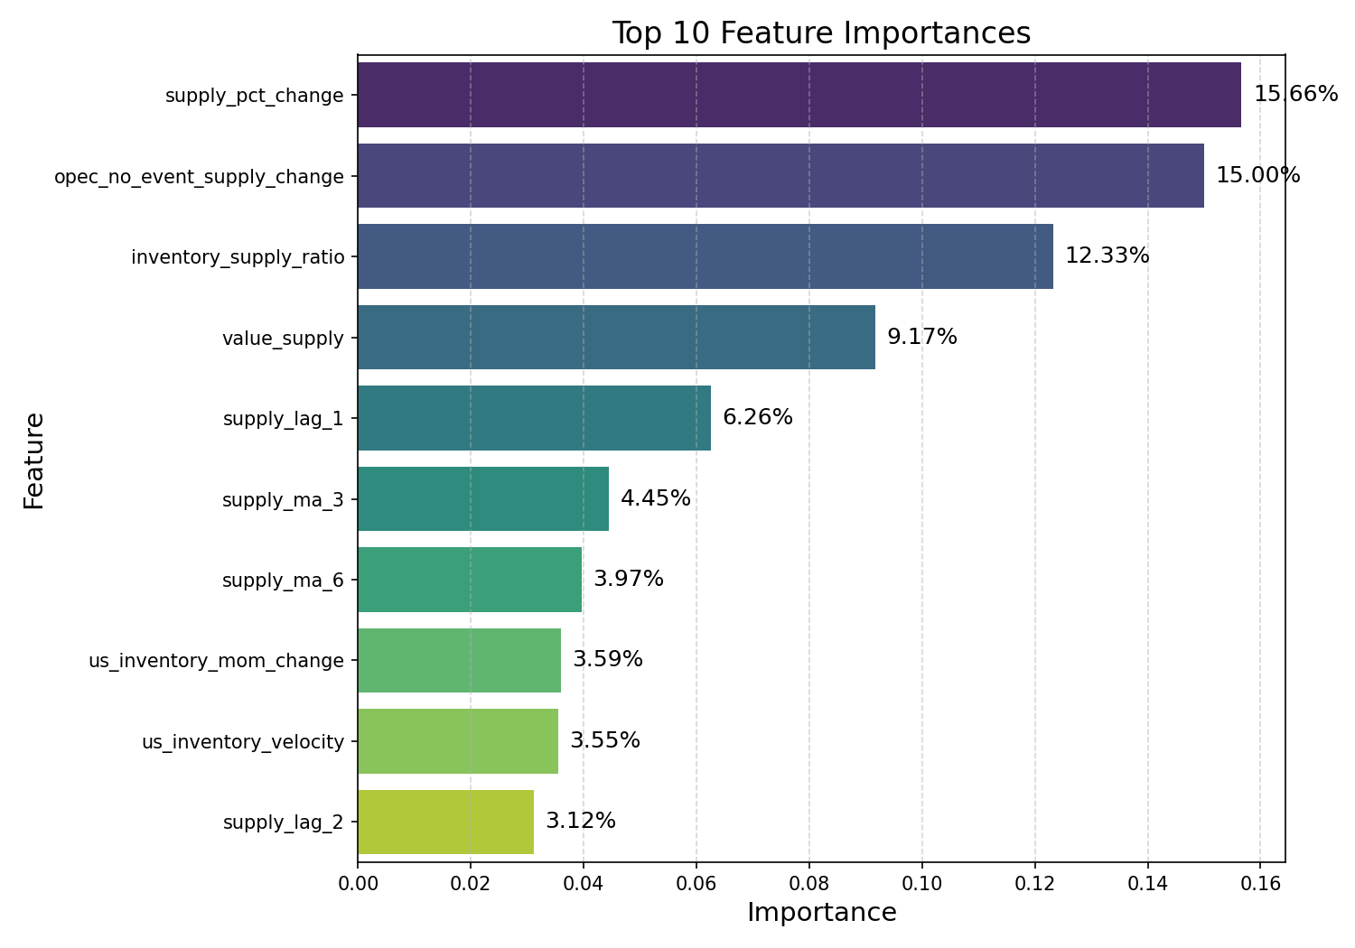
Feature Importance
1.Supply Data
(Total:59%)
2.Policy Data
(Total: 31%)
3.Inventory Data
(Total: 1%)
Notes:
When I looked at feature importance
I found that Supply data contributed about 59% to the model,
Policy data about 31%,
Inventory data about 1%.

Slide 12
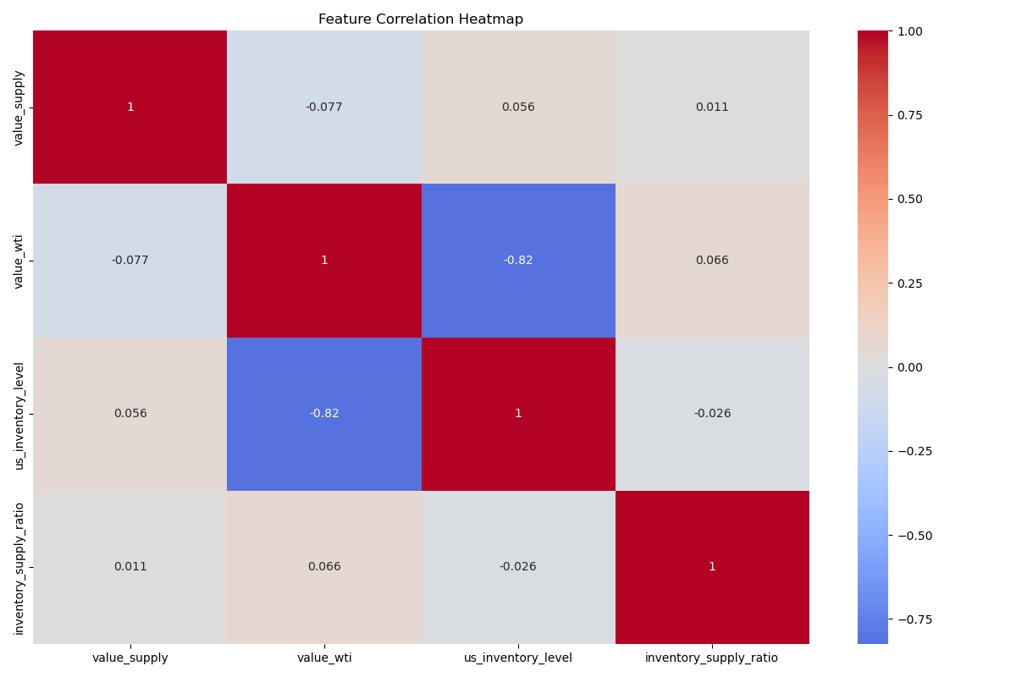
The strong negative correlation between US crude oil inventory levels and WTI price is the most noteworthy feature relationship.
Notes:
Even though supply and price don’t have a strong direct relationship, supply is still a key feature when the model looks at everything together.

Slide 13
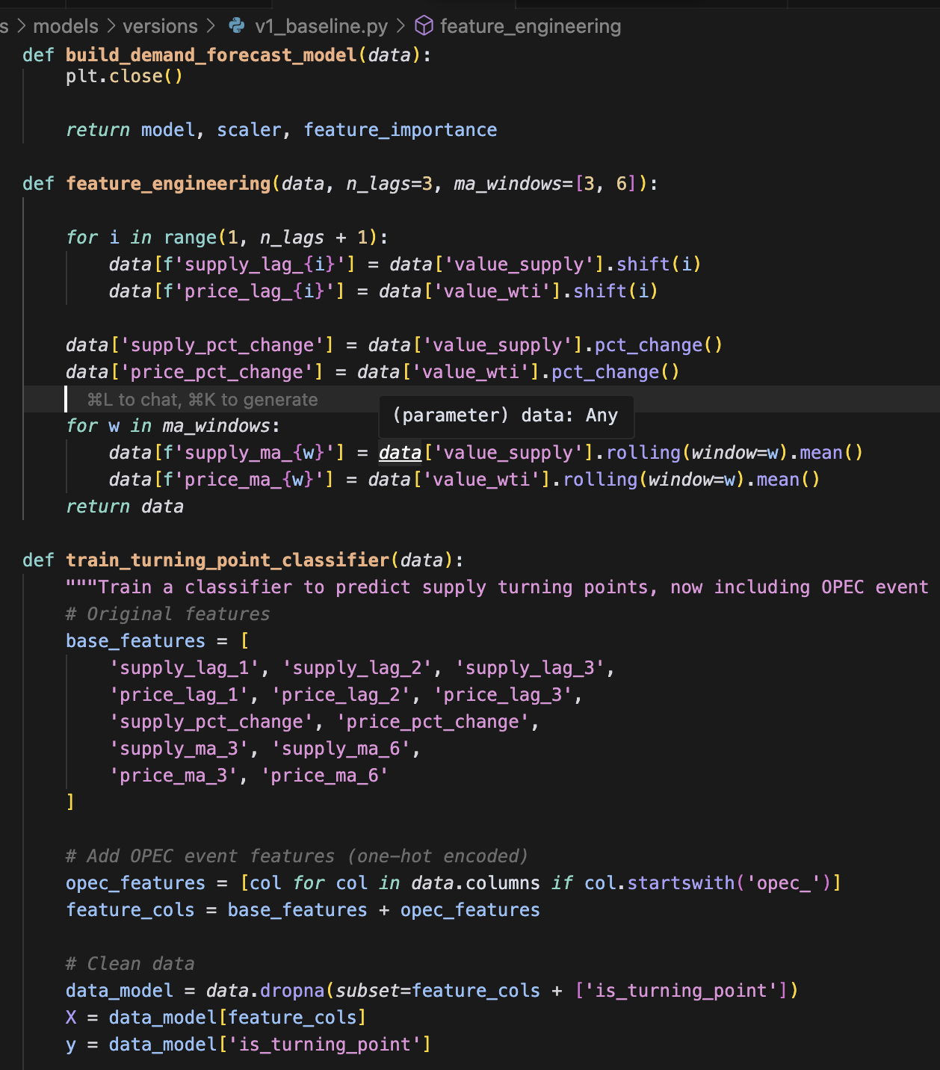
Model 1
it defines basic features, then performs data cleaning and preparation, followed by an 80/20 train-test split in chronological order, trains the model using RandomForestClassifier,

Slide 14
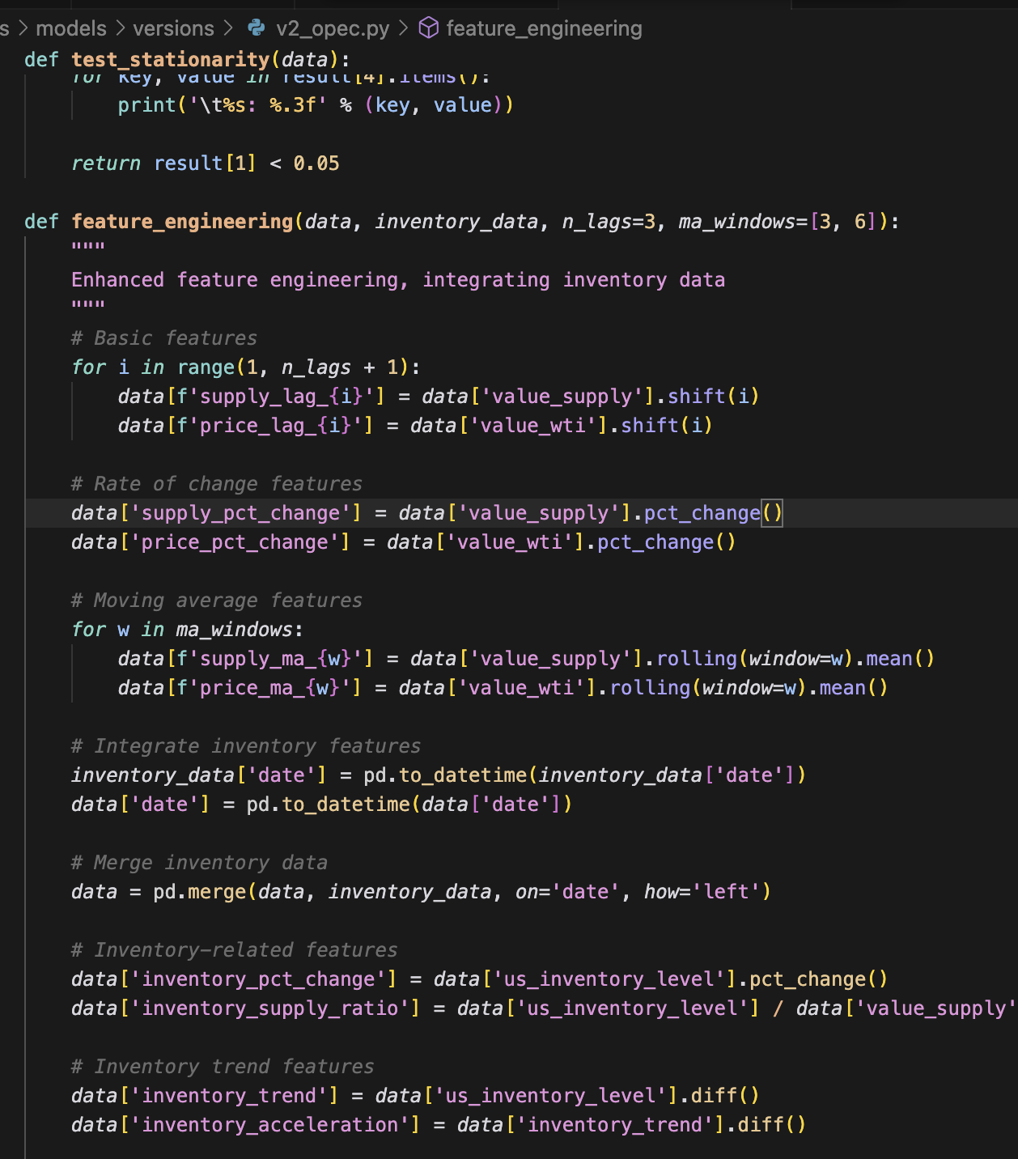
Model 2
Add inventory-related features
Enhanced feature engineering

Slide 15
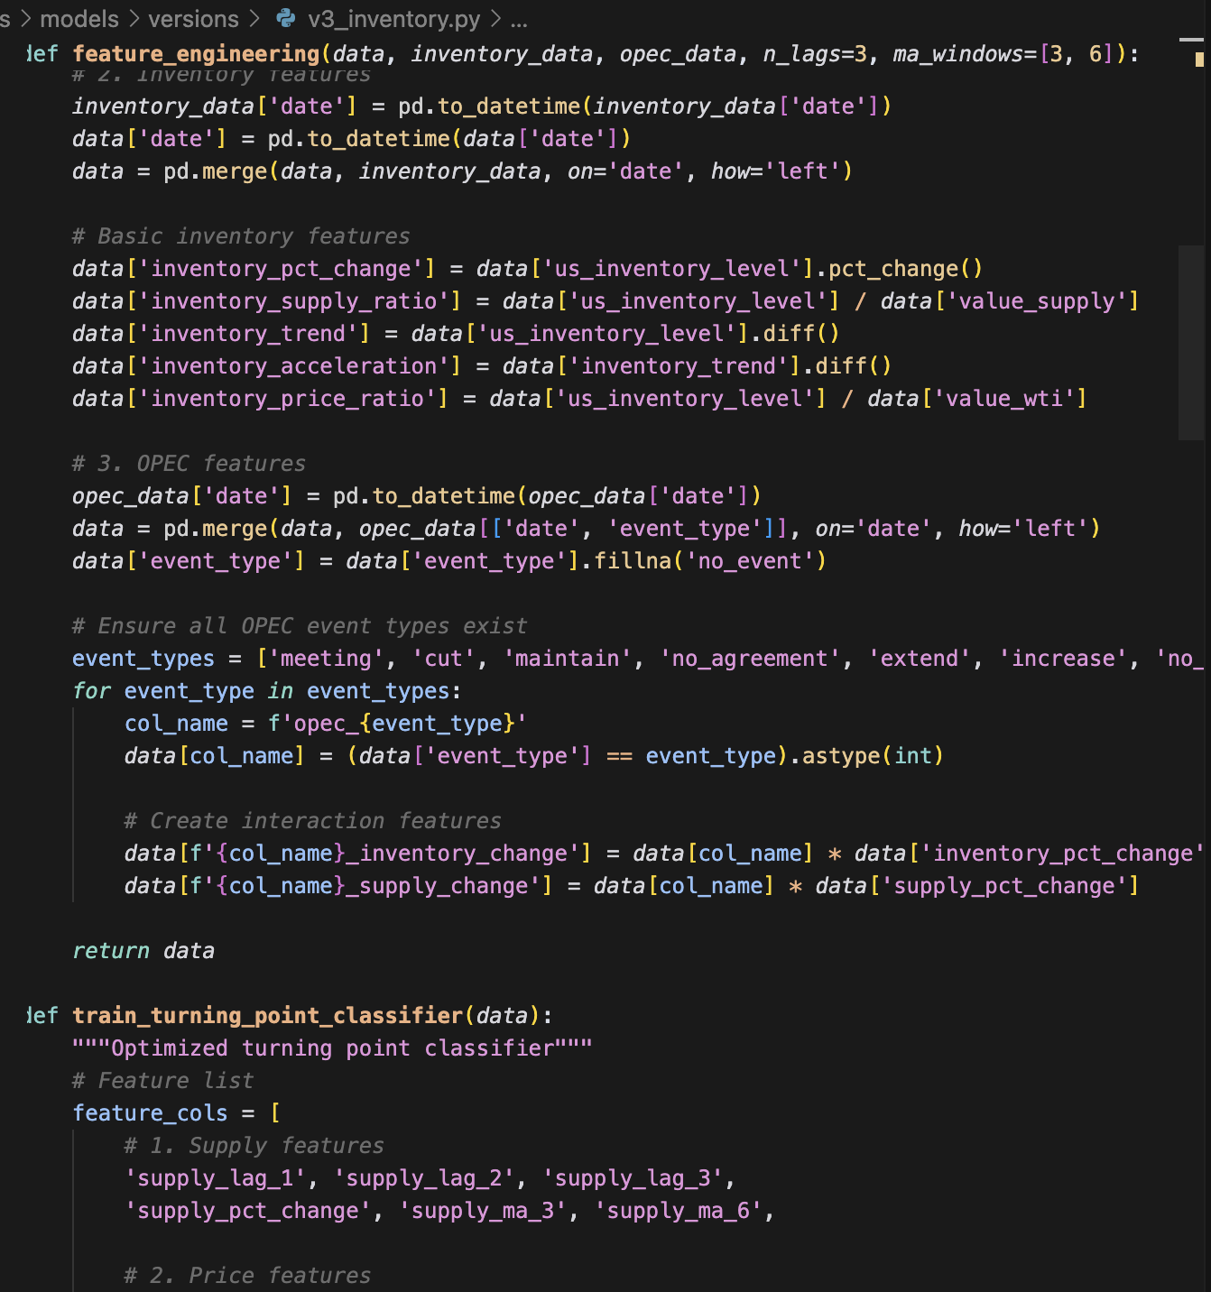
Model 3
Add Opec features
Here, the OPEC policy events are divided into seven categories: meeting, cut, maintain, no_agreement, extend, increase, and no_event.
Enhanced feature engineering

Slide 16
Further improvements
1. Data Granularity Expansion:
Changing the time granularity from monthly to daily or weekly can help capture more detailed market fluctuations and short-term policy impacts, thus improving the model’s timeliness and sensitivity.
2. Policy Feature Enhancement:
Refine the classification and quantification of policy events such as OPEC actions, for example by introducing event intensity, duration, or using NLP techniques to analyze policy texts, so as to more accurately reflect the real impact of policies on the market.
Notes:
There are two things I want to do next:
Use more detailed data: If I can get daily or weekly data instead of monthly, the model might catch more short-term changes.
Better policy features: I can try to describe other policies in more detail, maybe by looking at the strength or length of each event, or even using text analysis

Slide 17
[1] O. Durand-Lasserve and A. Pierru, “Modeling world oil market questions: An economic perspective,” Energy Policy, vol. 159, p. 112606, 2021. doi: 10.1016/j.enpol.2021.112606.
[2] F. Cheng, T. Fan, D. Fan, and S. Li, “The prediction of oil price turning points with log-periodic power law and multi-population genetic algorithm,” Energy Economics, vol. 72, pp. 341–355, 2018. doi: 10.1016/j.eneco.2018.03.038.
Notes:
To sum up
This project shows that machine learning can predict changes in the oil marketThank you for listening!

